Slide 1
JavaScript
Language fundamentals
Arrays, Objects, JSON

Slide 2
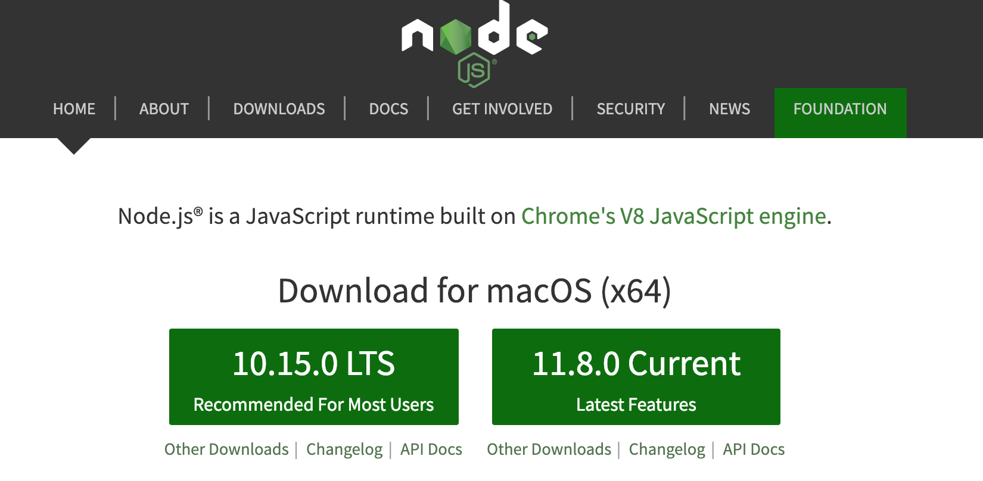
Install Node.js
Install the latest LTS (long term support) version
https://nodejs.org/en/
We'll use it to practice some JavaScript concepts by themselves, without needing to think about HTML too
Get the latest LTS version for your platform

Slide 3
Code samples
https://github.com/claraj/week4-examples

Slide 4
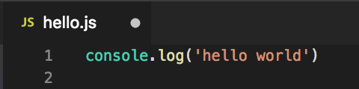
Create a new text file, called hello.js
Add this text
console.log('hello world')
Save your file

Slide 5
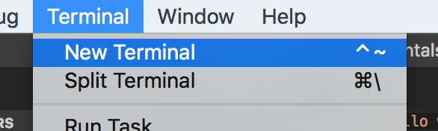
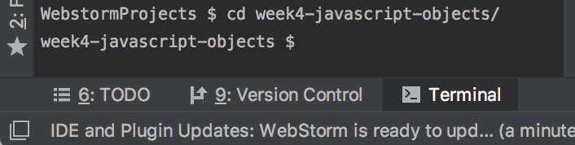
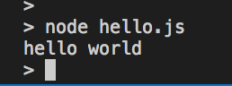
Run hello.js
In your terminal or command prompt, navigate to the directory hello.js is saved in
Your editor may have a a teminal built in, which should open to the correct location
VSCode: Tools > New Terminal
Webstorm: Click Terminal icon, bottom icon bar, left side
Type this to run your code
node hello.js

Slide 6
Syntax
Whitespace has no meaning (unlike Python) but typically follows Python/Java/C# -like style for readability
Use { } to indicate blocks of code, for example, functions, loops, conditional statements
You can end lines with a semicolon ; or not, but it’s (rarely) needed. https://news.codecademy.com/your-guide-to-semicolons-in-javascript/

Slide 7
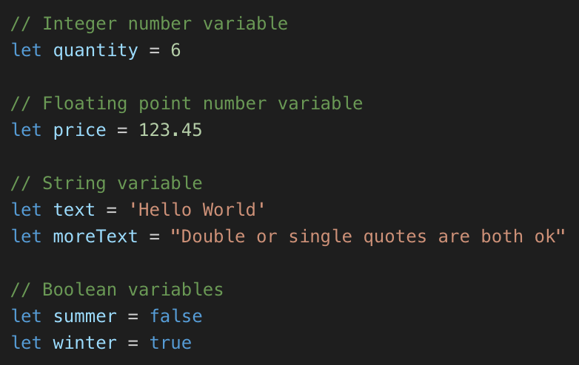
Basic Data Types Use let to create a variable
All numbers, integer and floating point, are stored in number variables
Like Python, JS figures out the type from the data being stored
String variables can use single quotes, or double quotes.
Boolean variables store true or false (Not True and False, like in Python)

Slide 8
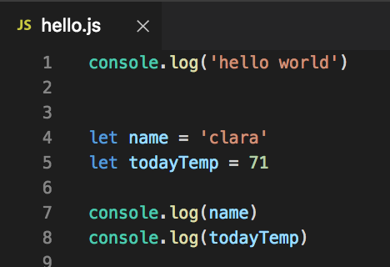
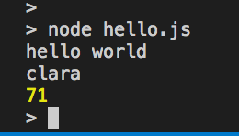
Your Turn - in the same file, or a new file
Create a variable with your name in
Create a variable with today's temperature (for example, 71)
console.log both variables
Run your program again
From the terminal node hello.js
Tip: press the up arrow key in the terminal to recall previous commands

Slide 9
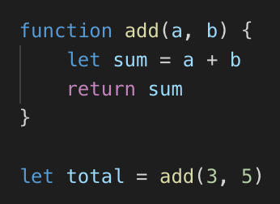
Defining Functions
Example: defining and calling a function using function keyword
a, b are function parameters, used to send data to the function
Use { } to contain function body
return keyword returns data to the caller

Slide 10
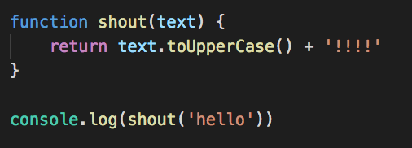
Defining Functions
text is the function parameter, used to send data to the function
return keyword returns data to the caller
Prints HELLO!!!!

Slide 11
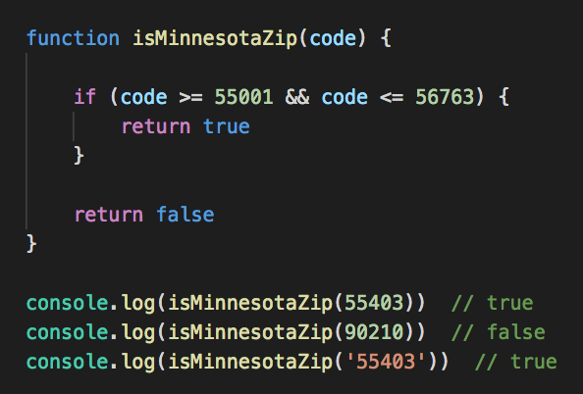
Defining Functions
All of Minnesota's zip codes are between 55001 and 56763
A function to check if a zip code is valid for Minnesota
https://www.zip-codes.com/state/mn.asp#zipcodes

Slide 12
Functions - your turn
Write a function that takes a GPA value as a parameter
Return true if the GPA is between 0 and 4
Return false otherwise
Call your function to check it works
If you call your function with -3 or 4.1 it should return false
If you call your function with 2.5 or 4 it should return true

Slide 13
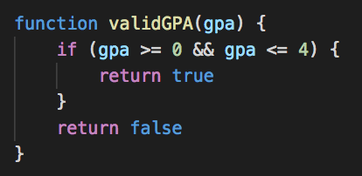
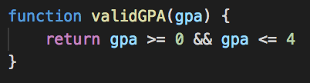
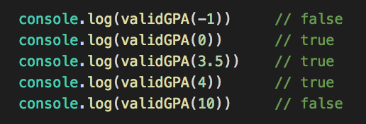
GPA checking function
Example solution
More concise variation

Slide 14
Functions - your turn
Write a function that joins the name of a city and state
For example, 'Minneapolis' and 'MN'
Into one string, joined with a comma, in the form used in an address
For example, 'Minneapolis, MN'
Can you make sure the state is capitalized?
Example: convert 'mn' to 'MN'

Slide 15
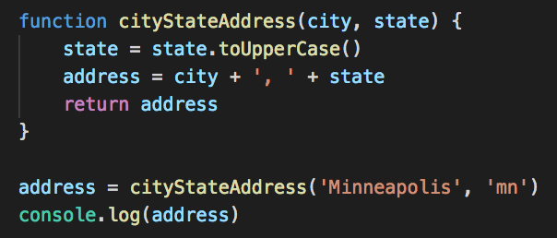
City and state example solution
Prints 'Minneapolis, MN'

Slide 16
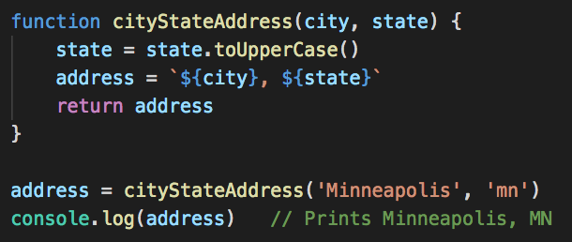
City and state example solution 2 - Template Strings
Use `
backticks
Anything in ${} will be evaluated and inserted into the string

Slide 17
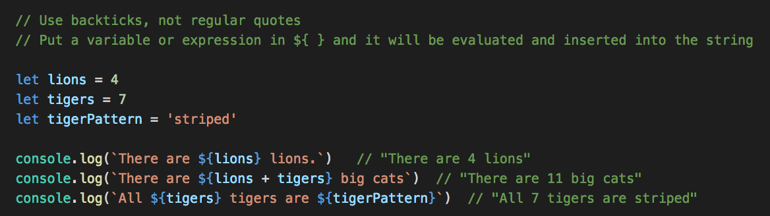
Template Strings
Can put variables or expressions in the ${}

Slide 18
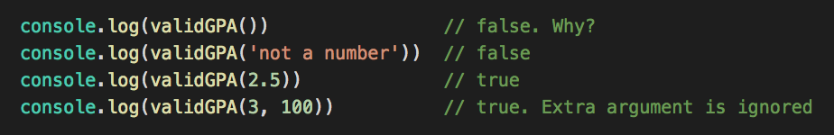
What happens if you call validGPA with a different number of arguments?
JavaScript does not require all of the arguments defined
It does not do any type checking
It will ignore any extra arguments - but you can access them if needed
If you don't provide an argument, it will have the value undefined in the function

Slide 19
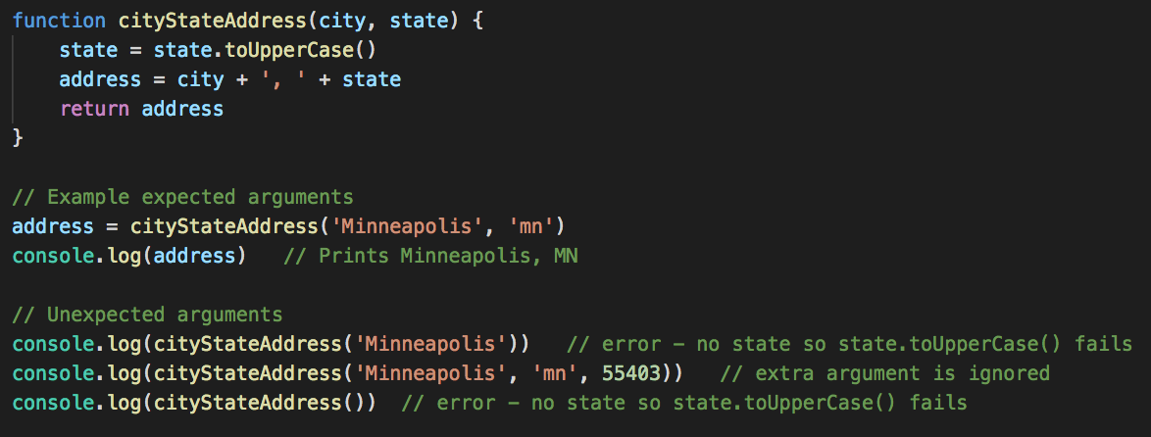
What happens if you call cityStateAddress with a different number of arguments?
Calling a function on an undefined value is an error

Slide 20
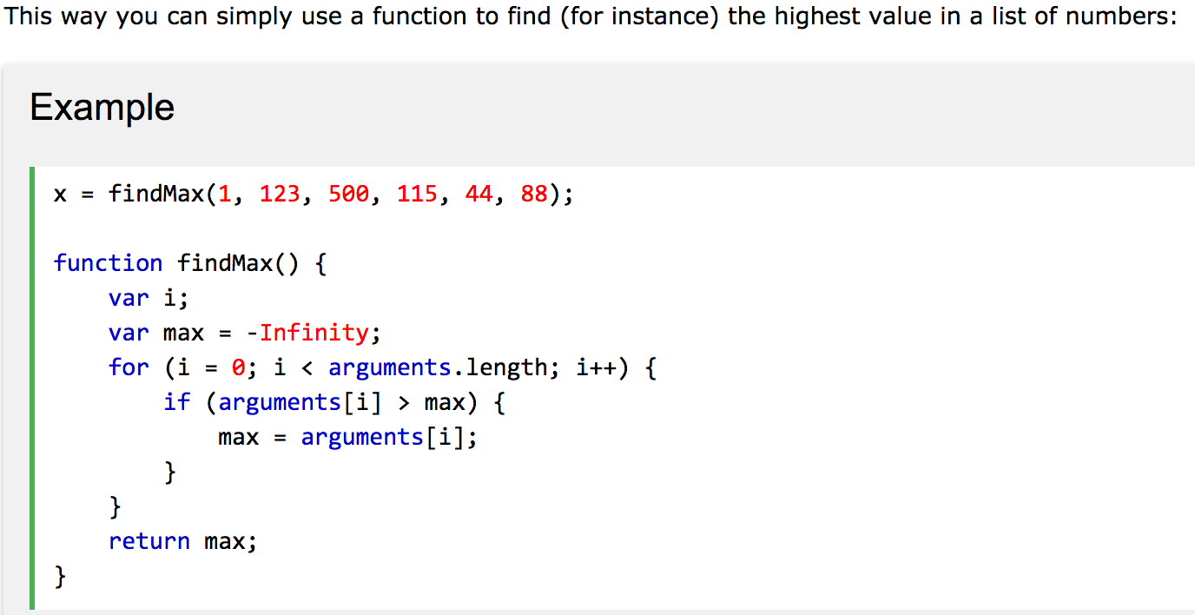
Extra arguments to a function are available in a variable called arguments, this can be useful
http://www.w3schools.com/js/js_function_parameters.asp

Slide 21
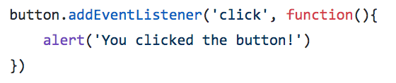
Function definitions as arguments to other functions
Very common in JavaScript
JavaScript can only do one thing at a time - it's asynchronous
Problem: for code that takes a long time to complete (e.g. fetch data from a server) the entire program has to stop and to wait until done
Problem: how to write code that will run in the future - for example, when a button is clicked?
So code that needs to be asynchronous is invoked by calling a function, and that function typically takes a function definition - a callback function - as an argument.
For slow tasks - the callback function will be called when the slow task completes,
For event handlers - the callback function will be called when the event happens
This might sound weird and confusing – but we’ll see lots of examples

Slide 22
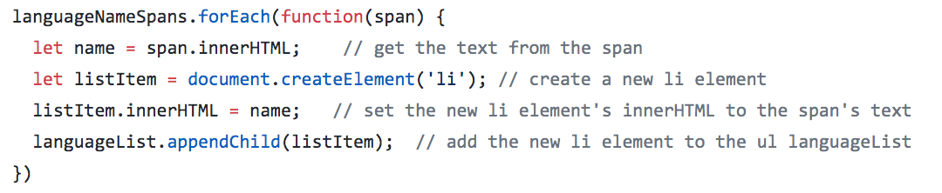
Function definitions as arguments to other functions Functional programming
Also used to implement functional-style code - example, forEach function
Most of the code you've written so far is imperative style - a list of instructions, mutate state in the program
Functional programming "treats computation as the evaluation of mathematical functions and avoids changing state and mutable data. It is a declarative programming paradigm, which means programming is done with expressions or declarations instead of statements." Wikipedia, https://en.wikipedia.org/wiki/Functional_programming
A good intro https://codeburst.io/a-beginner-friendly-intro-to-functional-programming-4f69aa109569

Slide 23
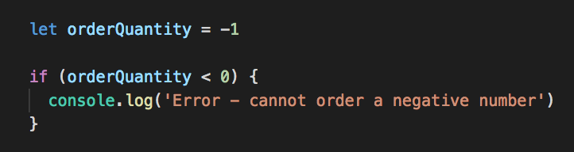
If Statements
Similar operators as Java, C#, Python === < <= > >= !== The ( ) around the condition are required Use { } to contain the conditional statement(s)

Slide 24
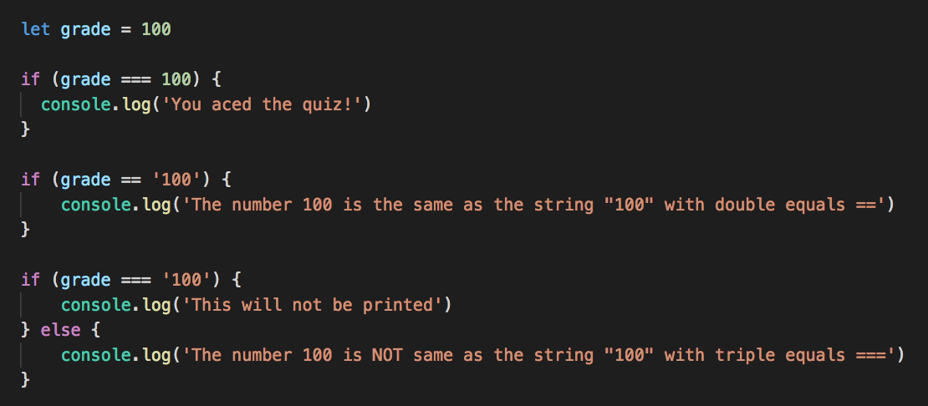
If statements - testing for equality
== will attempt to convert types before comparison, so '10' == 10
Three equal signs === will check the type of the variable being compared, they must be the same for the comparison to be true

Slide 25
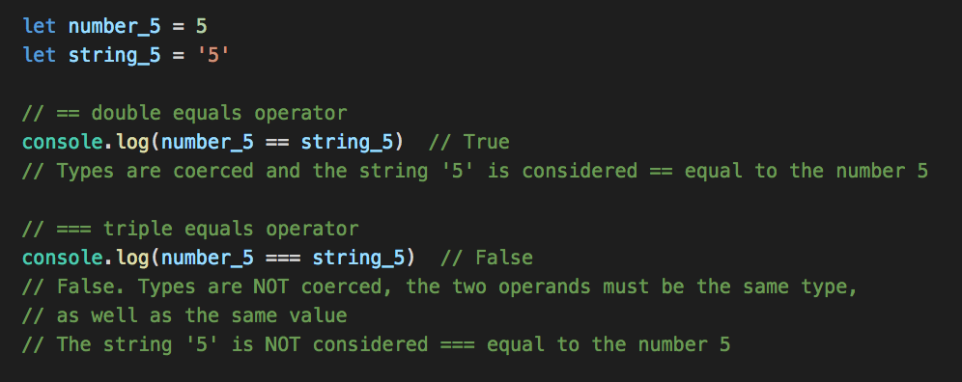
Is "5" equal to 5 ?
Using the == operator, if variables can be coerced to the same value, they are considered equal
To make JS check type as well as value, use the === operator
There's a !== operator for checking non-equality
If not sure which one to use, it's usually best to use the === and !== versions, since their behavior is more likely to be what you want

Slide 26
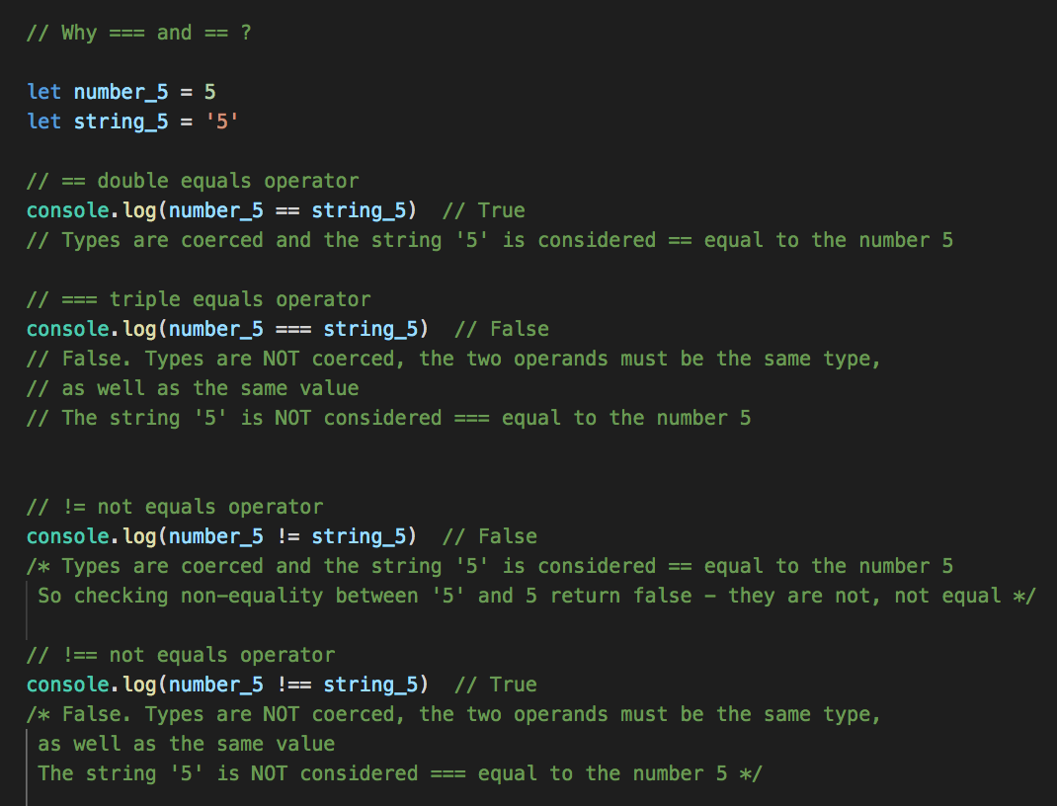
!= and !==
Use !== unless you know you want types to be coerced
Example: all values in HTML inputs are strings, even for values like 100
So you'd use == to check

Slide 27
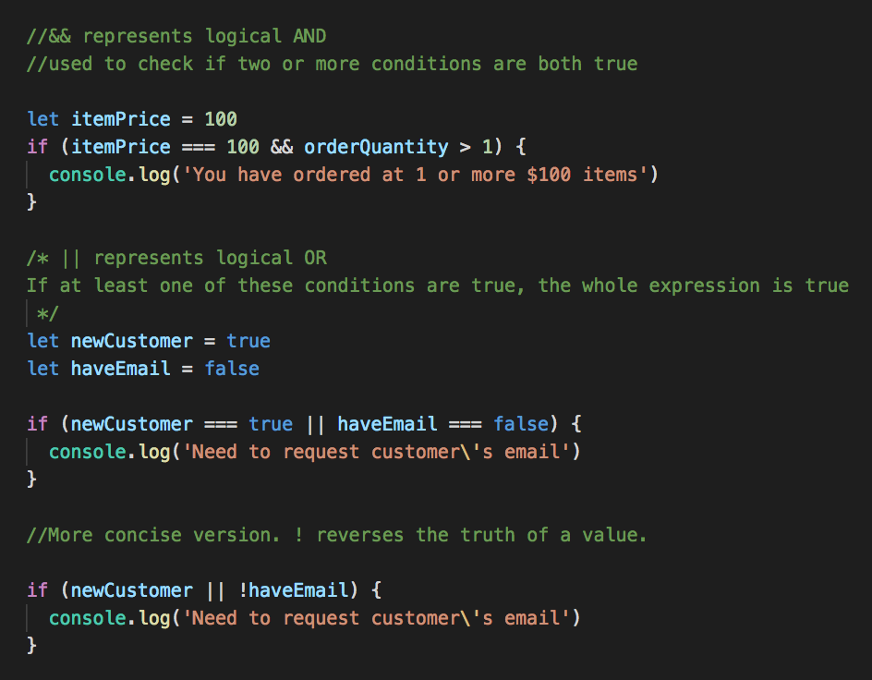
AND and OR || for OR && for AND

Slide 28
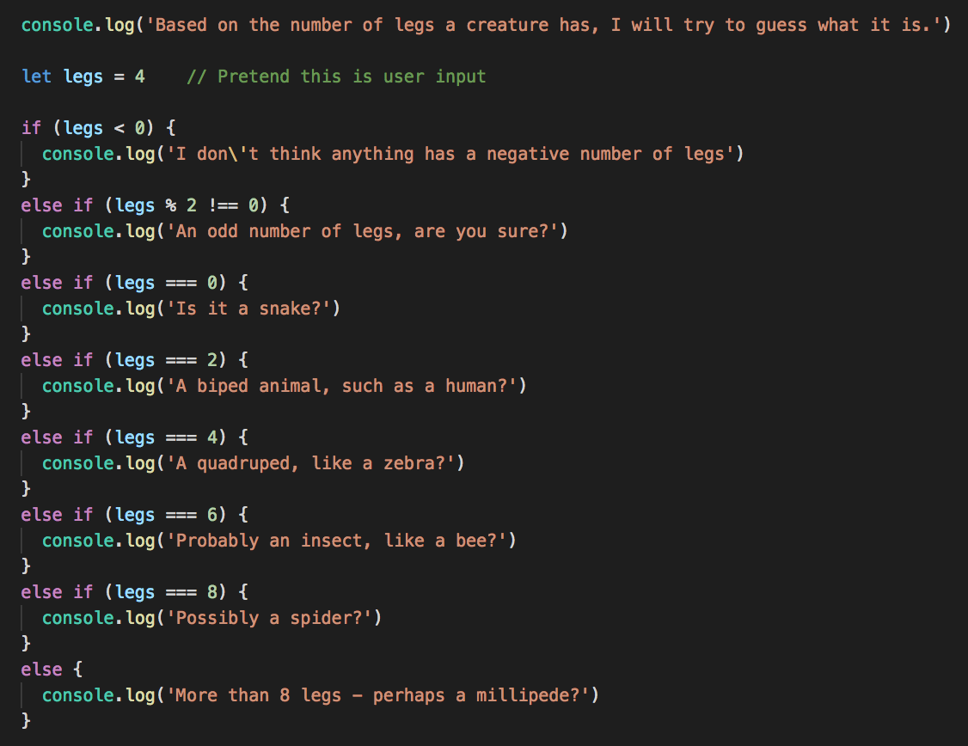
If / else if / else
Use as many else if clauses as needed

Slide 29
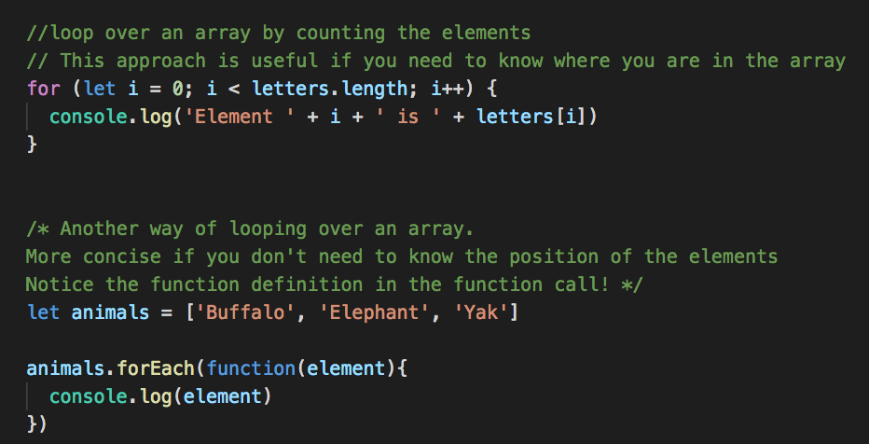
Loops in JavaScript
Looping over a NodeList or array – two ways
First way should look familiar if you’ve taken C# or Java

Slide 30
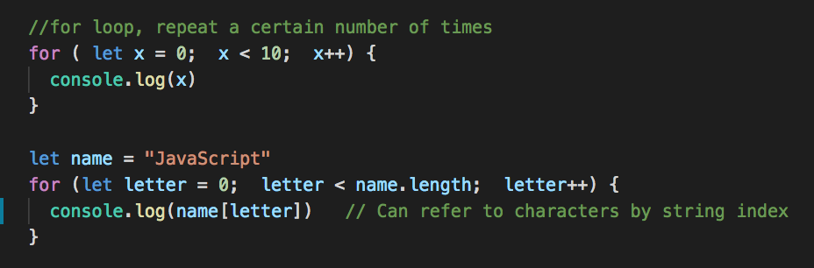
For loops examples

Slide 31
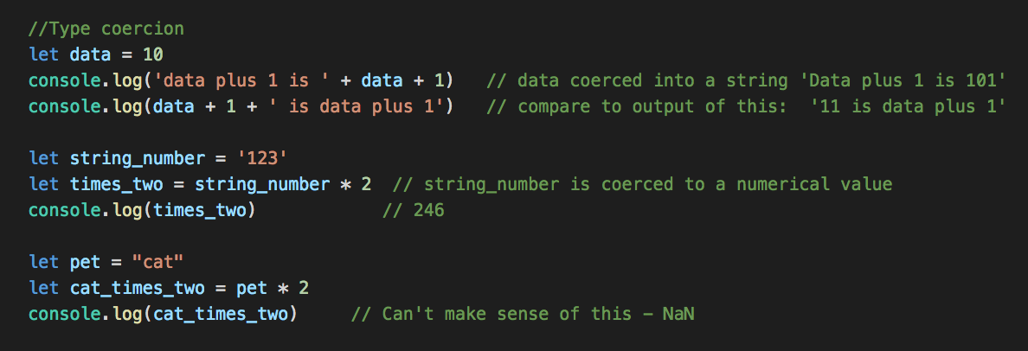
Type coercion
JavaScript isn't strict with types; if it is asked to work with a type it doesn't expect, it tries to convert (coerce) it to the correct type; usually it carries on even if the result doesn't make sense, which can lead to weird errors
JS will try and convert types if possible, to make sense in the context of an operation

Slide 32
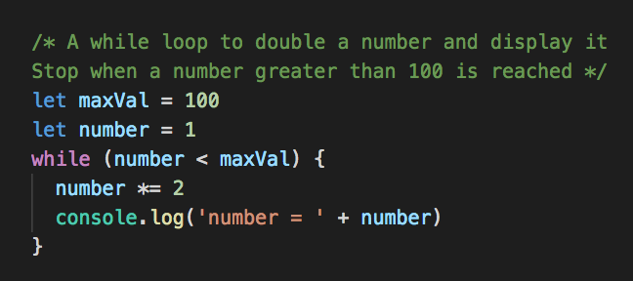
While loops
Same concept as Python, note the () around the condition and {} for the loop body

Slide 33
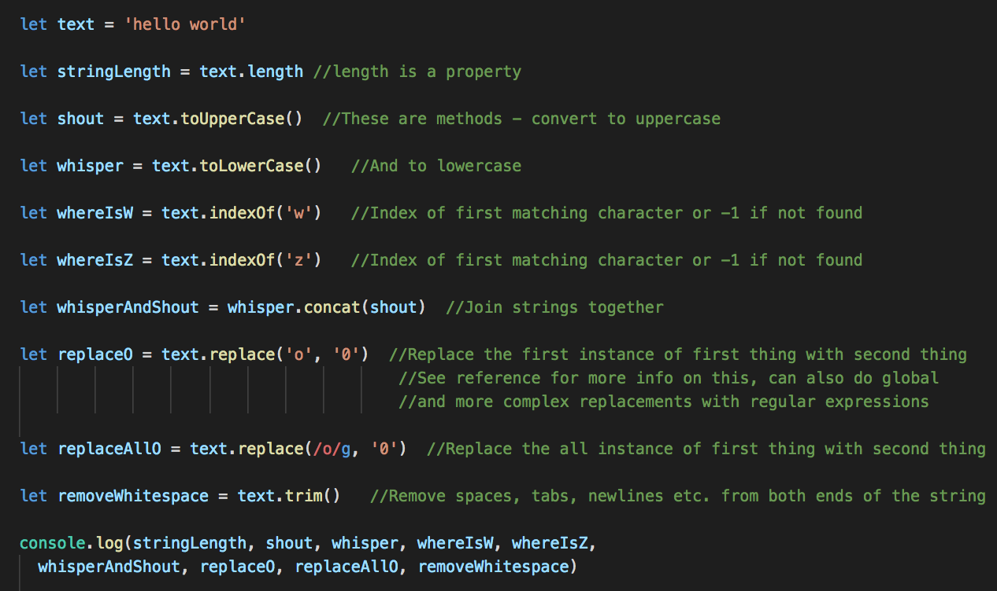
Strings: Various library functions
https://developer.mozilla.org/en-US/docs/Web/JavaScript/Reference/Global_Objects/String

Slide 34
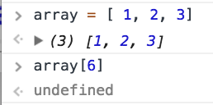
Special values; Undefined, null, NaN, Infinity
undefined: a variable that has not been defined. Example: reading a value from a non-existent array element
null: a value that indicates 'there is no data here'
e.g. if plotting a graph of daily temperatures and you don't have data for one day, you can set the temperature to null
Not the same as null in C# or Java – null in Java/C# is more similar to undefined in JS

Slide 35
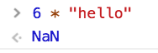
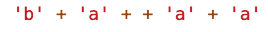
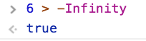
Special values; Undefined, null, NaN, Infinity
NaN: not a number. Often the result of doing math with Strings or non-numerical data
Weird JS – this is valid JS, what does it evaluate to? Why?
Infinity and –Infinity to represent highest and lowest possible numerical values

Slide 36
Weird JavaScript
Take care when programming in JavaScript
There's many cases of subtle, weird behavior
It will let you make mistakes that Java/C#/Python won't, which often cause hard-to-find bugs
Testing your code is very important
https://github.com/denysdovhan/wtfjs

Slide 37
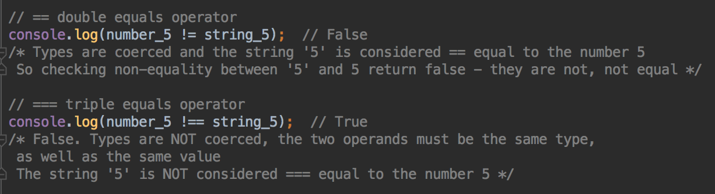
Comments
Single line comments start with //
Multi-line comments start with /* and end with */
Single line comment
Multi-line comment

Slide 38
Comment your code!
Labs and projects expect you to comment your code
Comment should focus on the more complex parts of your code
Explain your code to yourself
Exercise: read a piece of code you wrote last semester. Do you know what it does? Did you comment it? Did that help you understand?
I read code I wrote 6 weeks ago and have no idea what it does if I don't write comments!

Slide 39
JavaScript Arrays and Objects

Slide 40
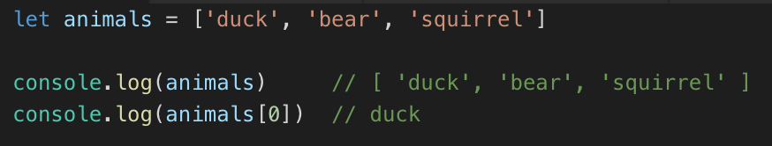
JavaScript Arrays
Use [] to define an array
Length is not fixed, can add and delete elements
Use array[index] to access and modify elements

Slide 41
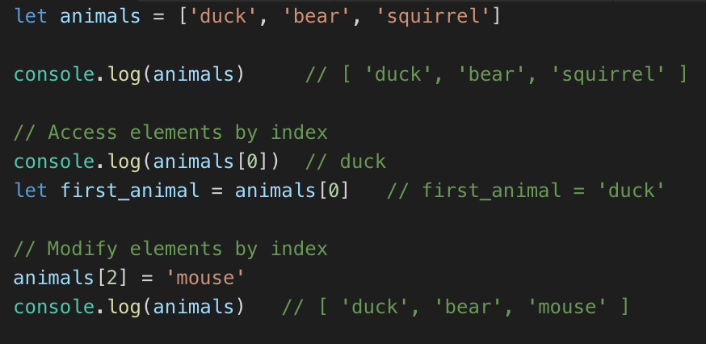
Modifying Elements
Modify by index

Slide 42
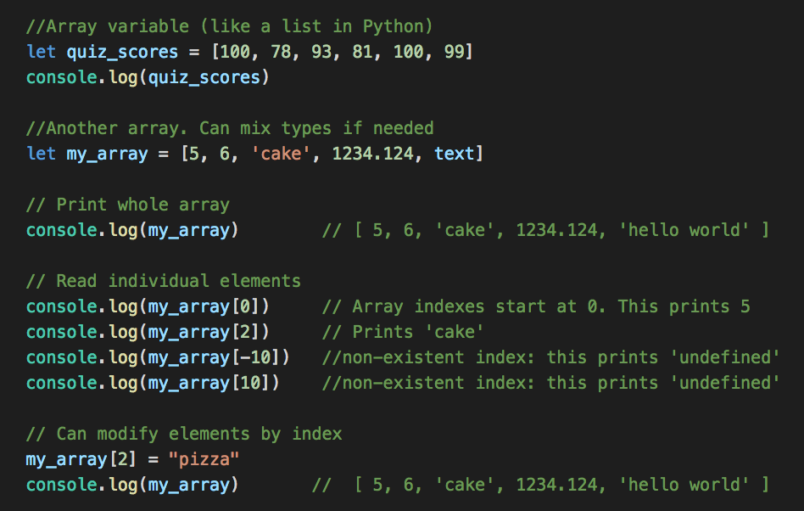
Creating your own Arrays
More like lists in Python, can change size of array
Define with square brackets [ ]
Can store the same type, or mix of types
Read and write individual elements with [] notation

Slide 43
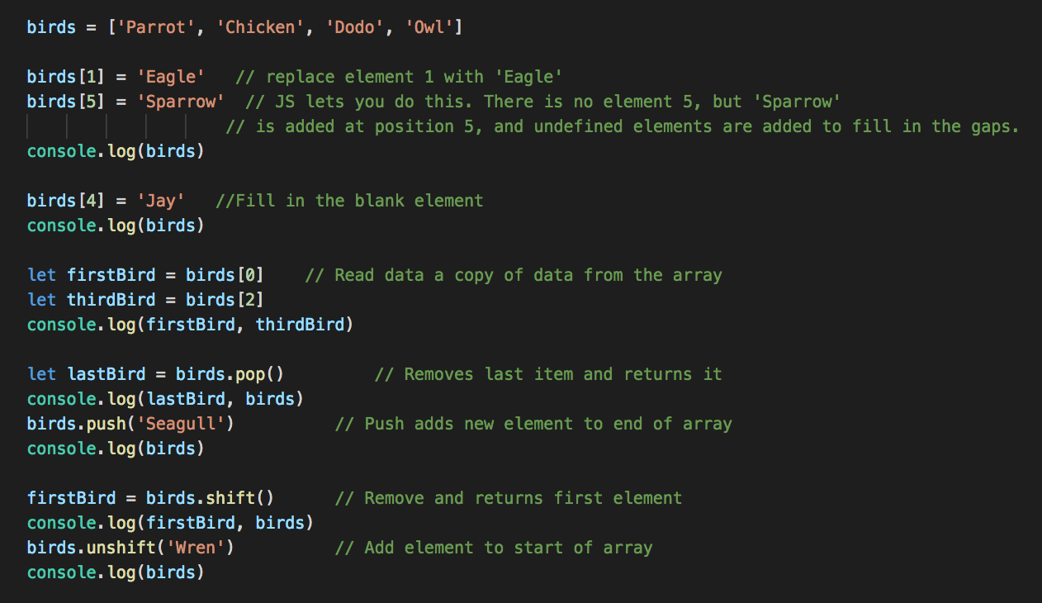
Array Manipulation

Slide 44
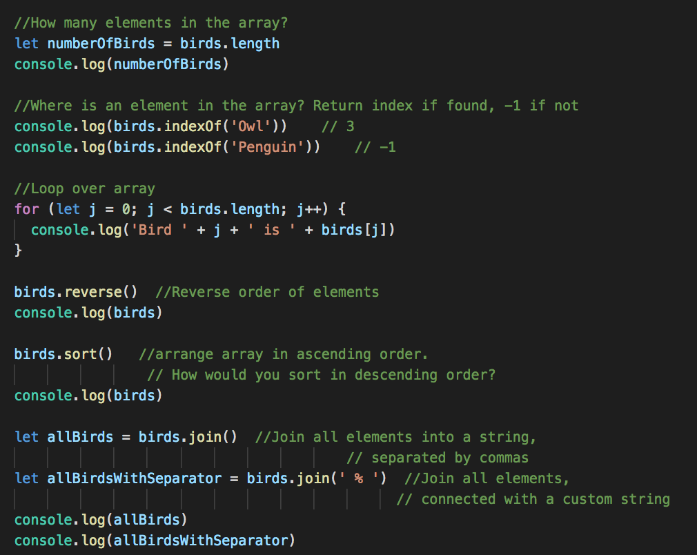
Array Manipulation

Slide 45
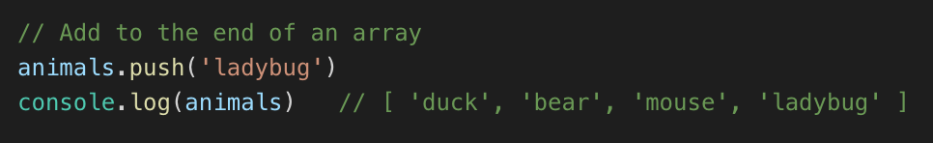
Adding elements
push adds an element to the end of an array

Slide 46
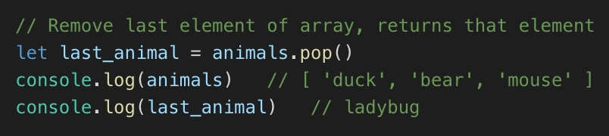
Removing elements
pop removes and returns the last element

Slide 47
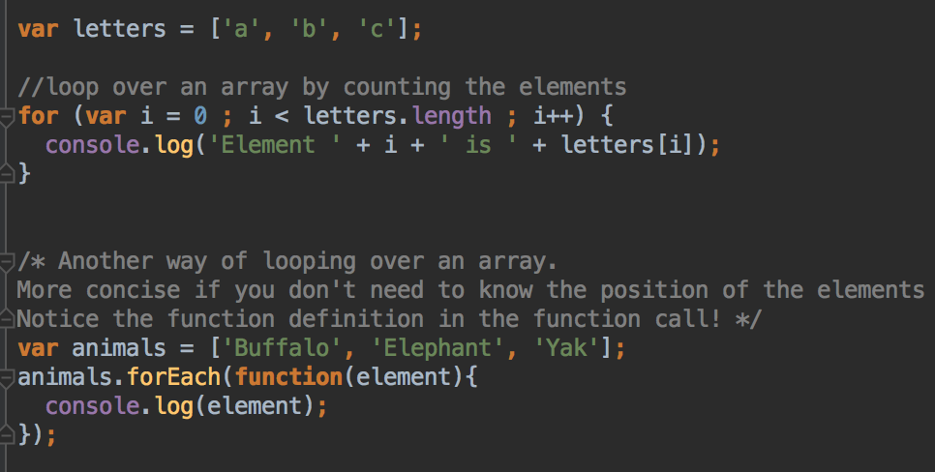
Looping over Arrays

Slide 48
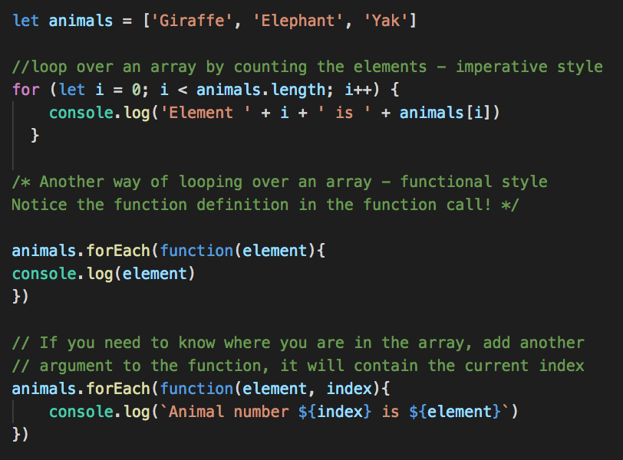
Looping over an array
Imperative and functional approach
Which do you prefer?

Slide 49
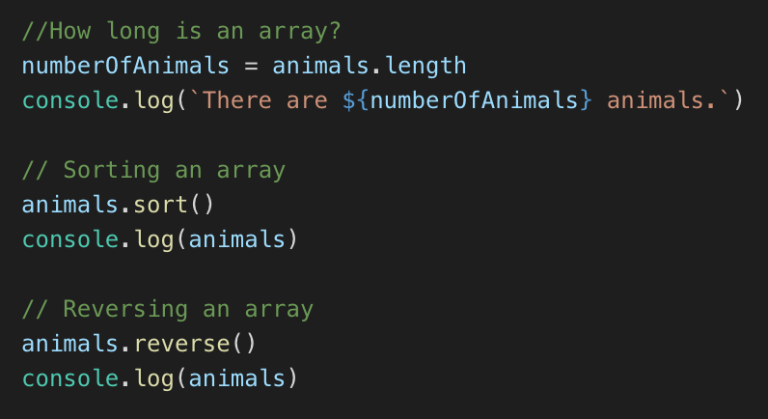
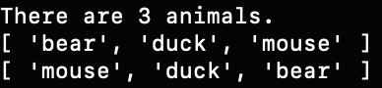
More array operations – length, sort(), reverse()

Slide 50
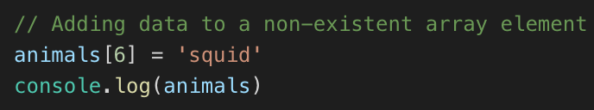
Adding data to an array
What if you try to add data to element 6 of the animals array?
The array only has 3 elements
JavaScript will enlarge the array, put the new element in index 6, and the empty items will be undefined

Slide 51

Reading data from an array
Similarly, if you read data from an element that doesn’t exist, you get undefined returned
Be aware that your program won’t crash, unlike Python/Java/C#
Common cause of bugs

Slide 52

Arrays in the browser
Student list form, last week's lab
In a form, there could be many input errors
Use array to make a list of all the problems
push adds to the array
join joins all the errors strings for display
Check length property

Slide 53

Your Turn Tree order form
Start with this page
https://git.io/fjhtC
Complete the validation JavaScript
And display an order summary if the form is completed

Slide 54
Form validation
Why not rely on HTML form validation?
Not all browsers handle validation attributes in the same way
For example, Safari doesn't enforce required elements
HTML form validation is helpful...
But JavaScript form validation is more reliable in the client, and more user friendly
When we get to servers, we'll talk about why JavaScript validation is ONLY to be user friendly, and why you should validate AGAIN on the server before you save data. It's very easy to bypass client-side checks on data

Slide 55

JavaScript Objects
JavaScript is very relaxed about objects
Can create an object on the fly, no class definition needed
Use { } to define an object
Separate properties and values with :

Slide 56

Your Turn
Create a new file first_objects.js
Create an object containing your name and a fake password
Run your program from the command line / terminal with
node first_objects.js
Should print your name

Slide 57
Objects and JSON
Define object variables and data with JSON syntax
Pronounced "jason"
JavaScript Object Notation
Dictionary-like structure
{ property : value , property2 : value2 }
Values can be anything – strings, numbers, lists, other objects – so can have nested structure

Slide 58

Accessing and modifying data in an object
Access by property name
Two ways – dot notation and square bracket notation
Can you print your (pretend) password?

Slide 59


Modifying properties
Again, two ways – dot notation and bracket notation
Can you change your password and print the new value?

Slide 60

Modifying Objects
Can add attributes to objects
Just say myOb.myNewAttribute = newVal
Can you add an email and print it out?

Slide 61

Nested Objects
Values can be other objects, or arrays
Arrays can be composed of objects
These objects and arrays can contains more objects and arrays

Slide 62
Nested Objects
Create a user object for your information in your dream job:
name
email
password
contact
roles
In code, add an attribute for your salary, as a number
In code, add "server admin" to your roles
Add the office location, e.g. (location: "Minneapolis") to the contact object

Slide 63


Printing Objects
JSON.stringify(object) // all on one line
JSON.stringify(object, replacerFn, indent)
https://www.w3schools.com/jsref/jsref_stringify.asp Replacer function example - used to customize formatting

Slide 64
JSON
Is used in many contexts outside JavaScript
Many websites (and other systems) "speak" JSON to other systems; as part of their API
For example, an Android or iOS may request information from a website, and receive JSON data in return; the JSON will then be processed in Java or Swift

Slide 65

Looping and objects
Can loop over all of the properties of an object using a for …. in loop
As you loop over properties, you can access each property's value

Slide 66



Looping and Objects
Nested Example

Slide 67

Looping and Objects
The for (… in ... ) works for an object you create with the
{ a : 1, b : 2 } syntax
Other objects may have other properties that you may not want to include in the loop – for example, an object can have inherited properties
Use hasOwnProperty check to ensure that the current property does directly own each property
https://developer.mozilla.org/en-US/docs/Web/JavaScript/Reference/Statements/for...in

Slide 68
Lab 4 - More JavaScript Practice

